Slide 1
Business Dashboard Summary
Dashboard Design using Power BI
Superstore Dataset
Name-Shubham Dubey

Slide 2
Objective & Tools
Objective:
Design an interactive business dashboard for stakeholders using Superstore data.
Tools Used:
- Power BI
- Microsoft PowerPoint (for summary)

Slide 3
Key Performance Indicators (KPIs)
- Total Sales
- Total Profit
- Sales & Profit Growth (YoY/MoM)
- Category & Segment performance
- Regional performance

Slide 4
Dashboard Features
- Slicers/Filters for Region, Category, Segment, Date
- Cards for Totals (Sales, Profit, Orders)
- Time-Series Line Graphs for trend analysis
- Bar Charts for Category/Segment breakdown

Slide 5
Sample Data Insights
- Highest Sales from Technology category
- West region shows strong profit margins
- Office Supplies segment lags in profitability
- Seasonal spikes observed in each year

Slide 6
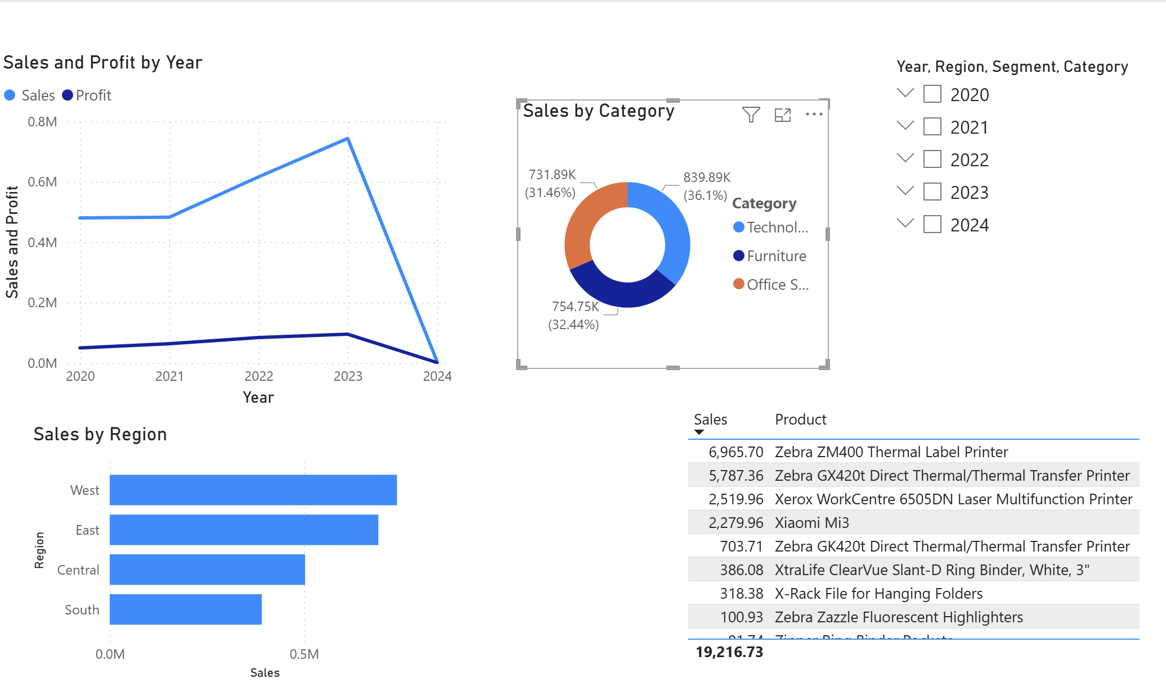
Insert Dashboard Screenshot Here

